Slide 1
Title

Slide 2
Meet Your Presenter: FirstName LastName
Certified Business Advisor for the Ohio SBDC at CSCC (Or Title)
Role at SBDC
Relevant Education
Relevant Experience
Personal Small Business Experience, if any (optional)

Slide 3
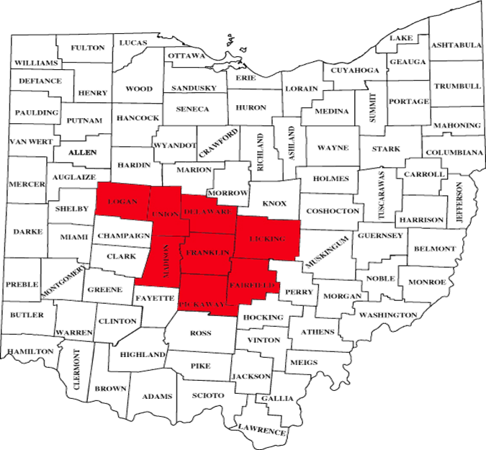
What is the Ohio SBDC?
Economic Development Entity – Joined CSCC 2004
National Network: 1000 nationwide, 27 state
Central Ohio - 8 County Region
No-Cost Business Consulting
Low to no-cost training conducted by certified business advisors or community professionals
Serve small business for the life of the business
Specialty programs: Manufacturing, Export Assistance and Latino

Slide 4
VISIT www.SBDCColumbus.com EMAIL SBDC@cscc.edu CALL 614.287.5294
For more information and to engage with the Ohio SBDC at CSCC…

